Slide 1
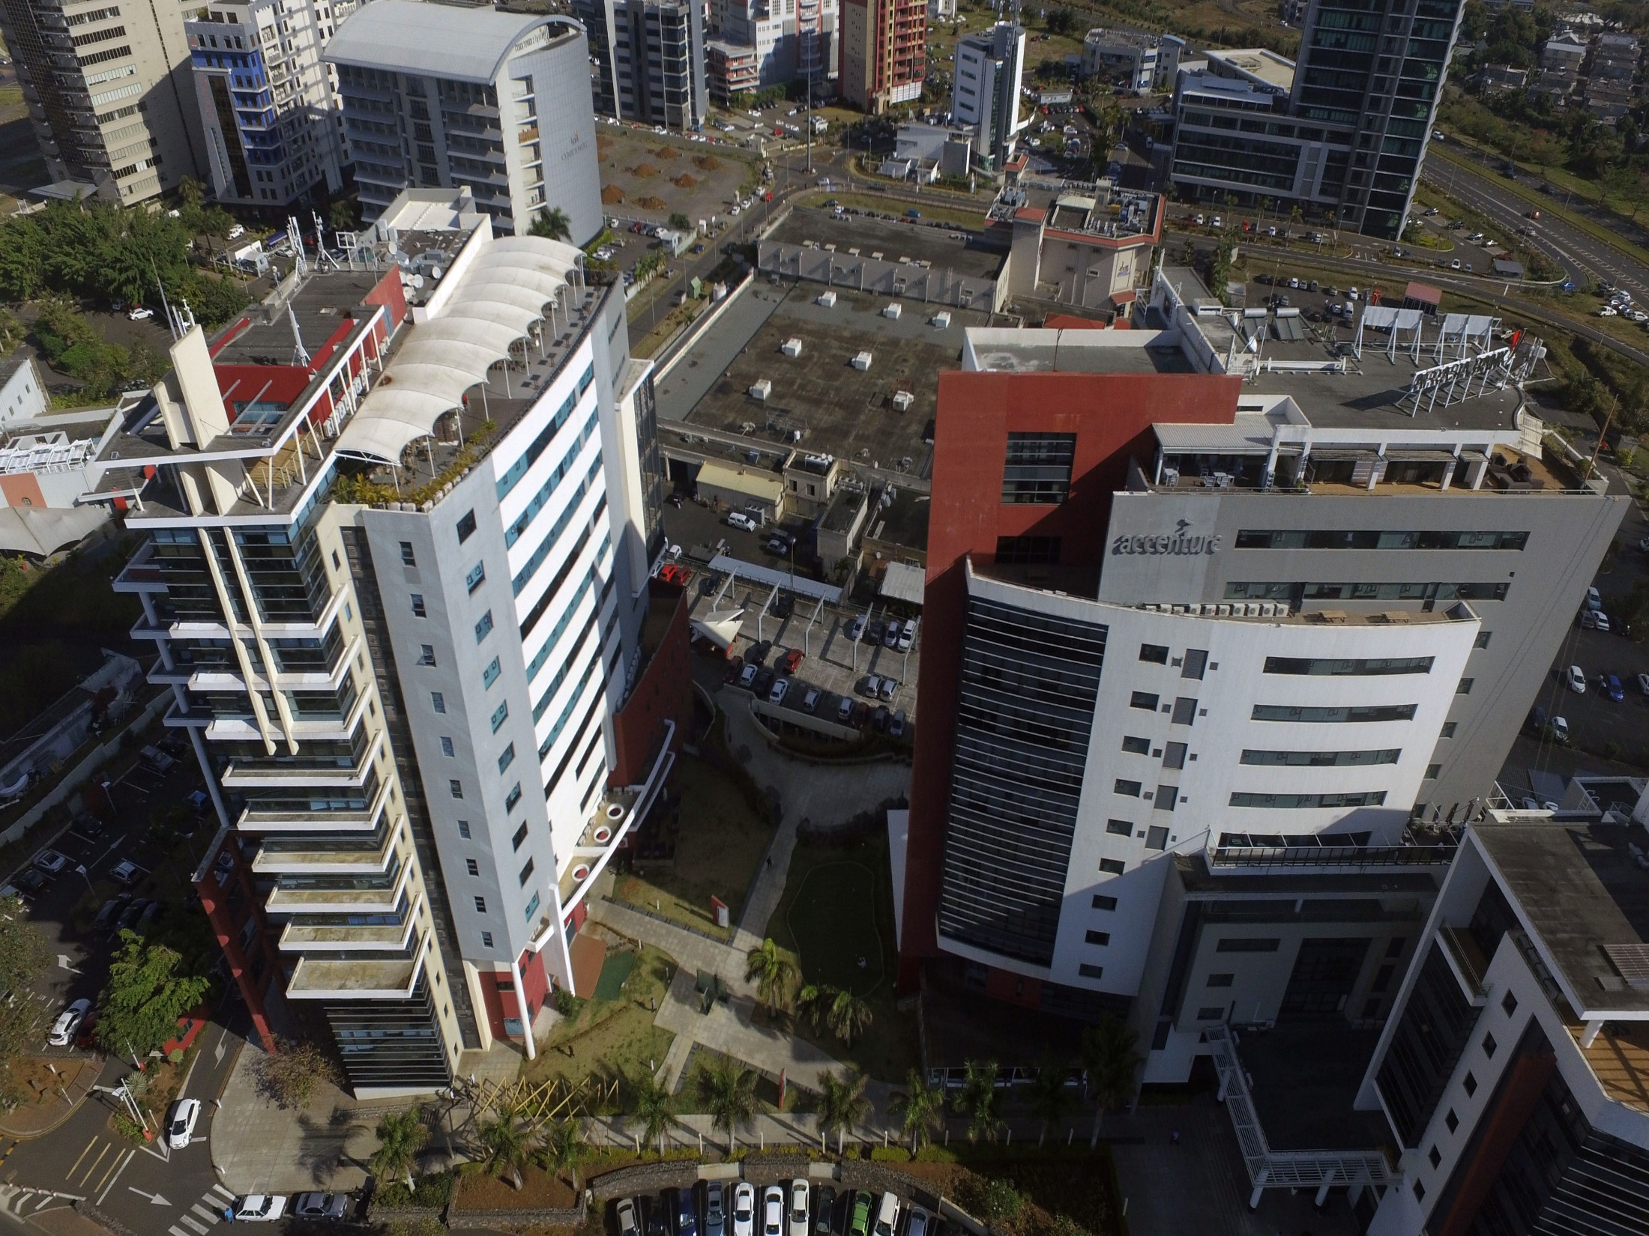
Enterprise
Archi
Tecture

Slide 2
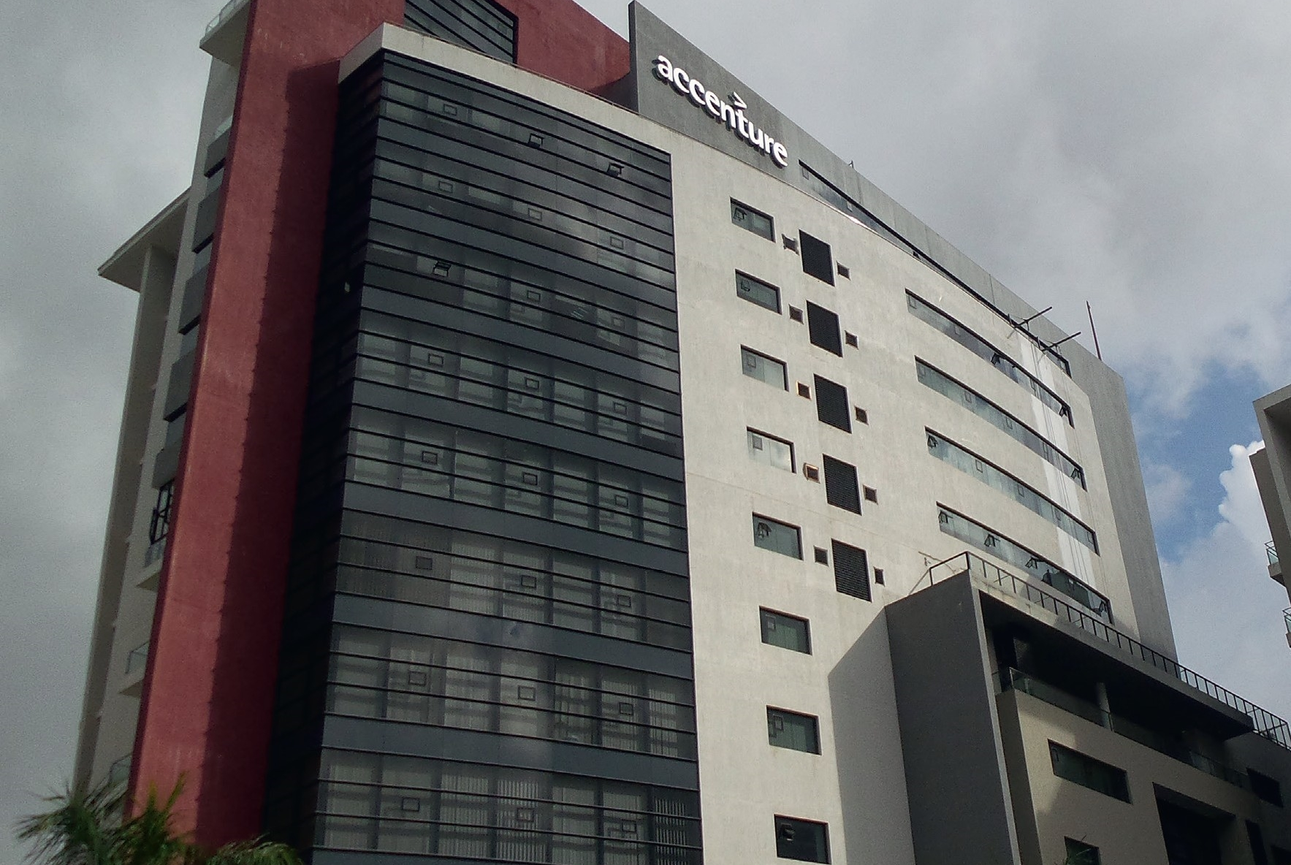
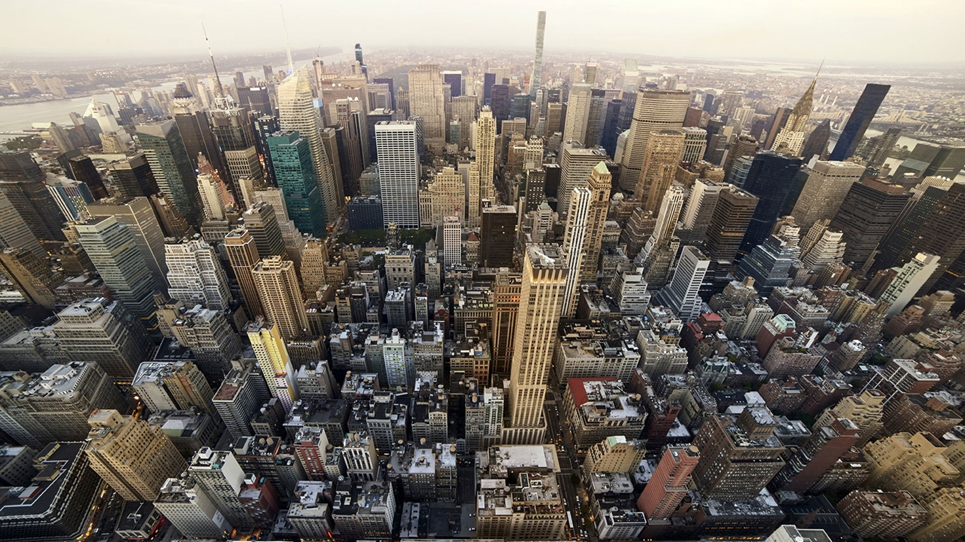
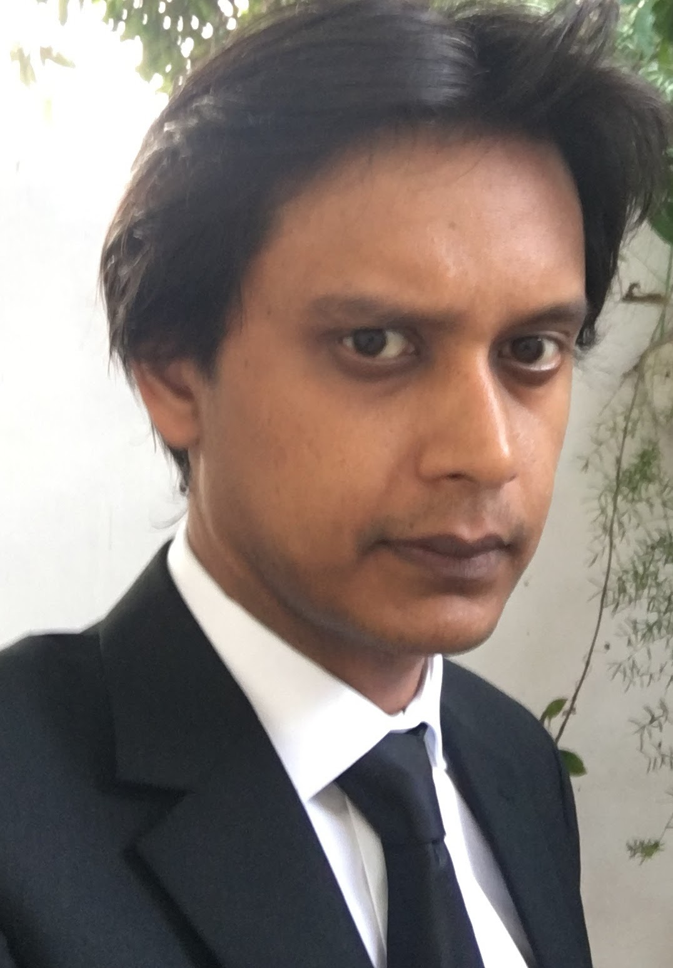










Accenture Technology
Global Workforce 380,000+
Mauritius Workforce 2,400+
Locations in Ebene 3
Clients 40+
Accenture Entities Technology and Operations
Accenture Technology 930+
About Presenter
Javed Mandary
Advanced Technology &
Architecture Lead
14 years experience
Specialized in
Enterprise Java
Architecture

Slide 3

Enterprise Architecture
Enterprise architecture (EA) “..applies architecture principles and practices to guide organizations through the business, information, process, and technology changes necessary to execute their strategies. These practices utilize the various aspects of an enterprise to identify, motivate, and achieve these changes."^{[1]}
Source Wikipedia
Implementation of Enterprise Architecture solutions starts just after Project Initiation
Architects capture the requirements and challenges from stakeholders e.g Business , IT
Architects define solutions and guidelines to correctly solve challenges
Enterprise Architecture blueprint is created that defines the guiding principles , methodology , practices and constraints
Proof of Concepts are executed to validate and refine the Architecture blueprint
Enterprise Architecture blueprint is handed over to Development Teams before the Design phase

Slide 4
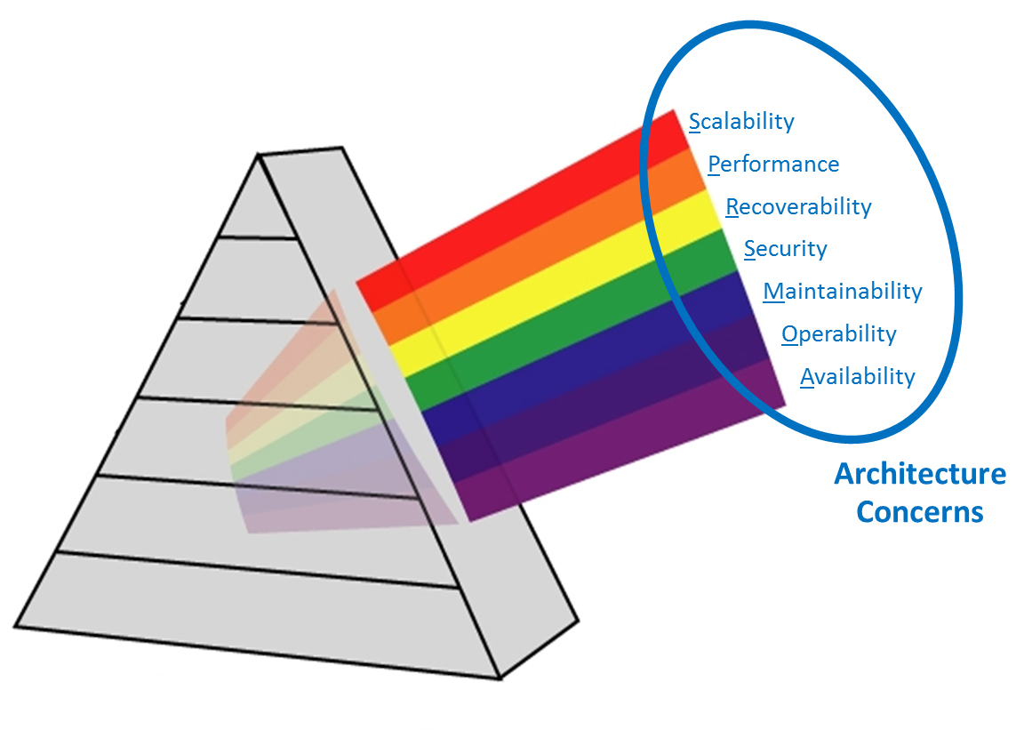


Architecture Concerns
Scalability
How many users or transactions does it need to process concurrently?
Performance
How fast does it respond? What is the max throughput ?
Recoverability
How does the application recover from a fault ?
Security
Can it sustain attacks ? Is data protected ?
Maintainability
How easy it is to maintain ?
Operability
How easy is it to use and manage ? How is it operated ?
Availability
Is it available 24x7? And is it 99.9% or 99.99%

Slide 5
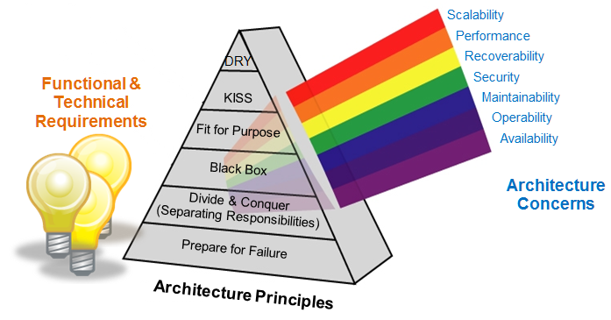
Architecture Principles
Prepare For Failure
Divide & Conquer
software, hardware, networks, people will fail that's part of life and we need to live with it, architectures should be designed to tolerate failure, or at least fail gracefully, recovery tools and/or processes should be defined.
Black Box
To manage complexity, responsibilities should be clearly separated between architecture components (e.g. classes, architecture layers, services, applications, sub-systems, etc.);
Fit For Purpose
Implementation details should be hidden behind stable, well-defined APIs or interfaces
Don’t Reinvent
The Wheel
The solution should do what it needs to do, not more and not less.
KISS
Keep It Short & Simple
If something is already available to do the job well, use it, don't waste time & money just to make something different
DRY
Don’t Repeat Yourself
Don't over-architect or over-engineer, the longest-lived, most robust systems also tend to be the easiest to understand
Each capability should be implemented only once, there should be no software or hardware duplication

Slide 6






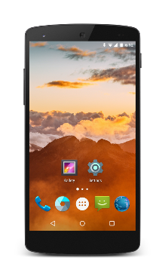


Example Architecture
Context
Web Assistant app
takes in textual input to interact with the bot
Virtual Agent ( chat bot ) to interface with the existing Overtime & transport systems as well as the meeting room book system in an organization.
Virtual Agent needs to :
Have Web and Mobile UI
Capture overtime requests
Capture transport details
Needs to be able to book meeting rooms
Machine Learning will allow for prediction on :
Transport requirements for certain days
- Usage of meeting rooms
Remote Systems called through existing API ( e.g REST) to fulfil the requirements of the bot
Machine Learning
Amazon LEX
Amazon Lambda
Amazon ML
provides predictions based on historical information
Overtime and Transport System
Meeting Room Booking System
Mobile Assistant app
makes use of phone sensors and input of user to fulfill requirements of user
Amazon LEX
drives chat bot features ( intents , slot types, etc..)
Amazon Lambda implements hooks to do more complex operations e.g calling remote systems

Slide 7
Business Architecture questions
Performance/Availability Requirements
Proposed performance metrics
Uptime requirements
Response Times
Business Continuity requirements
Proposed Business Continuity solution
Security requirements
Auditing requirements
What are the key Functional Needs ?
What is the System expected to do ?
What Are the Non Functional Needs?
safety, security , usability , testability, maintainability, extensibility and scalability?
Volumetric information
How many users are expected to use this system?
What is the impact of increasing the concurrent users beyond the planned maximum?
Example Questions
( non-exhaustive list )

Slide 8
Technical Architecture Questions
How will the solution be deployed?
Overview of the deployment to physical environments showing connectivity
What is the potential impact on existing solutions and what are the mitigations?
What Products/Versions are being used?
Overview of interfacing / messaging / data requirements?
What are the data archive plans?
Support Requirements
Which teams will support what aspects of the solution?
How will the system be monitored?
What scheduled downtime for support has been included?
How will the solution be deployed?
Overview of the deployment to physical environments showing connectivity
What is the potential impact on existing solutions and what are the mitigations?
What Products/Versions are being used?
Overview of interfacing / messaging / data requirements?
What are the data archive plans?
Support Requirements
Which teams will support what aspects of the solution?
How will the system be monitored?
What scheduled downtime for support has been included?
Example Questions
( non-exhaustive list )

Slide 9
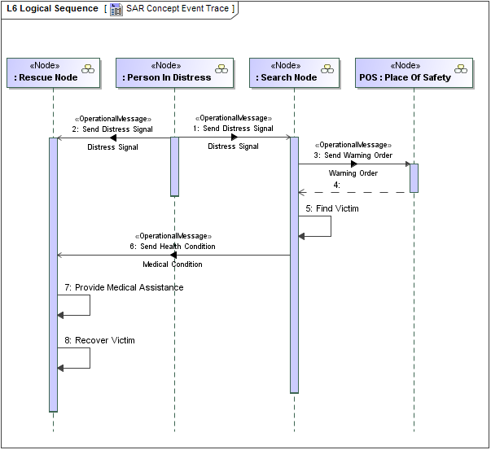

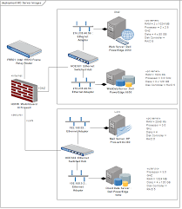




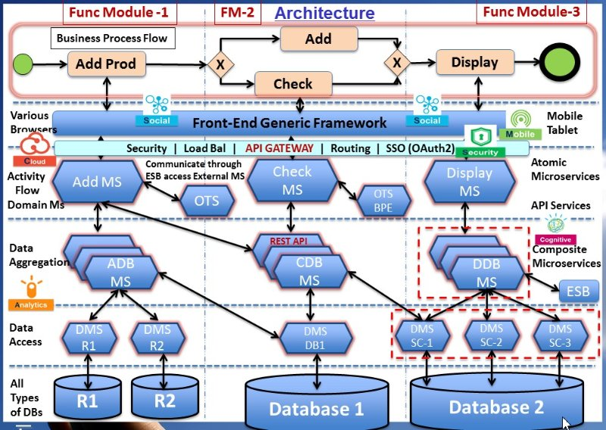

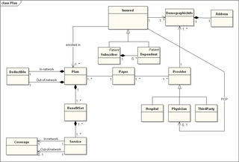







Architecture BluePrint
+
Business
Architecture
Technical
Architecture
Logical Seq. Diag.
TFS
Weblogic
Oracle
Hardware/Cloud
Architecture
Blueprint
Deployment Diag.
Software/Frameworks
HTML
CSS
JS
Domain Model
Architecture Diag.(s)

Slide 10


Questions ?
Contact Us
Accenture Mauritius Careers Website
www.careers.accenture.mu
Visit our website:
www.accenture.com
careers.mauritius@accenture.com

